Slide 1
UCSD Embedded C Assignment 5
By
Hsuankai Chang
hsuankac@umich.edu

Slide 2
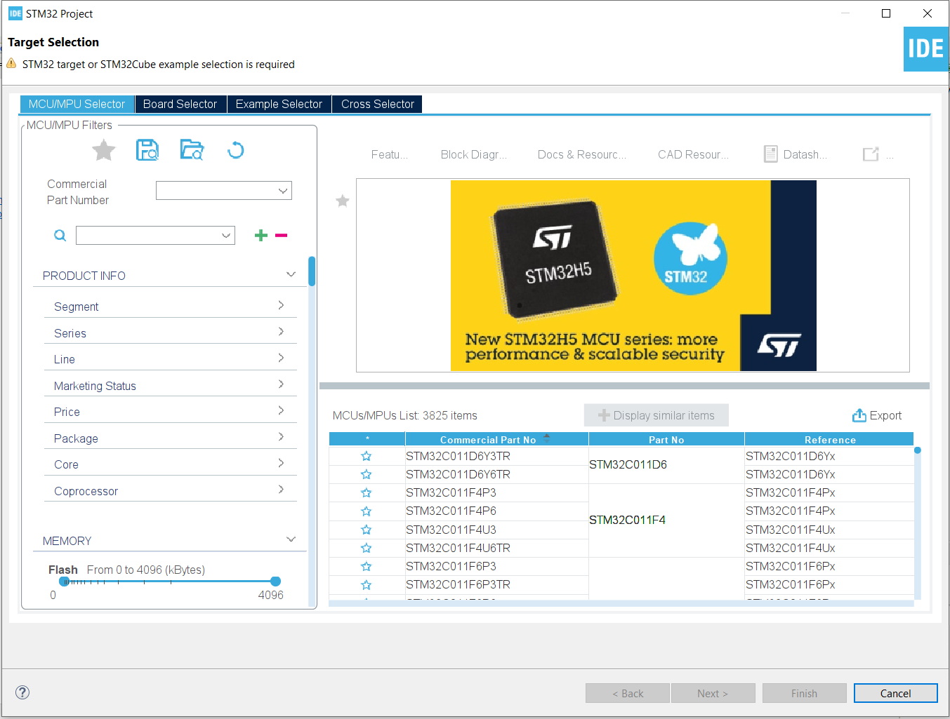
Step 1. Startup STM32CubeIDE and create new STM32 project

Slide 3
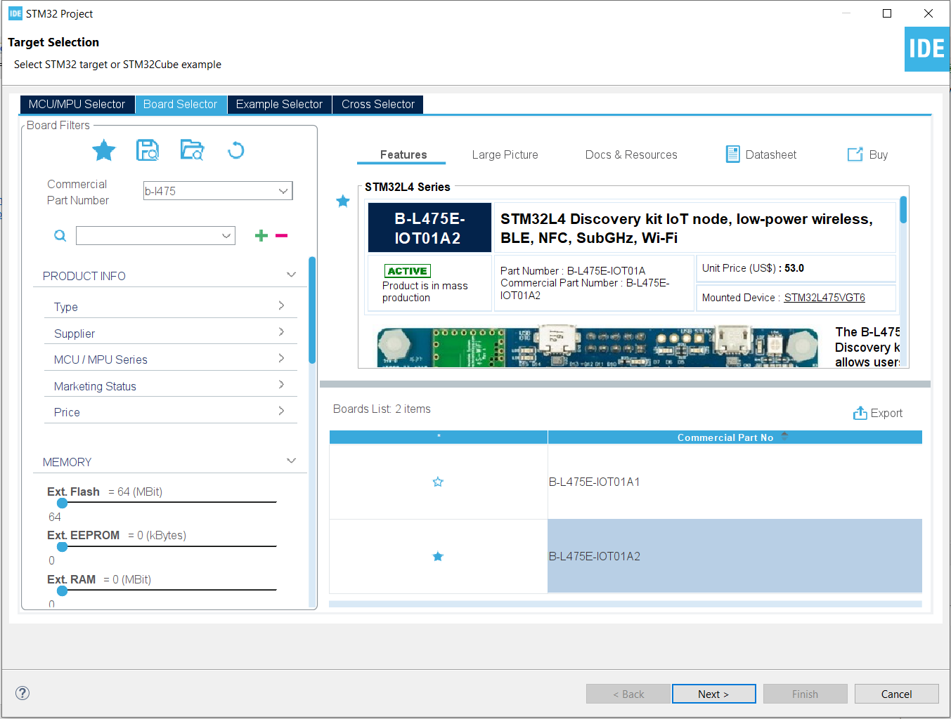
Step 2. Access board selector and type in the board you use, click Next

Slide 4
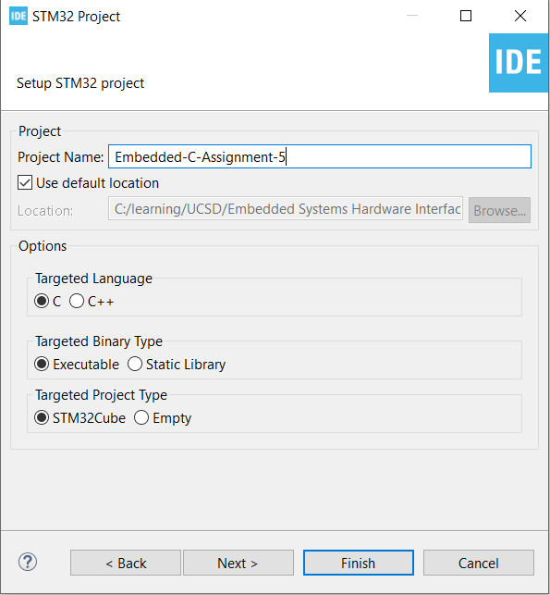
Step 3. Enter the project name then click Next

Slide 5
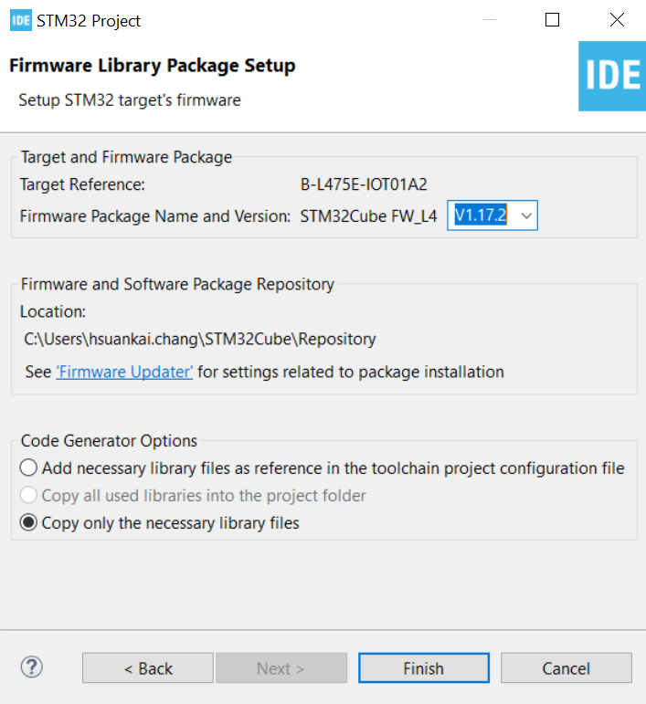
Step 4. See the firmware package name and version

Slide 6
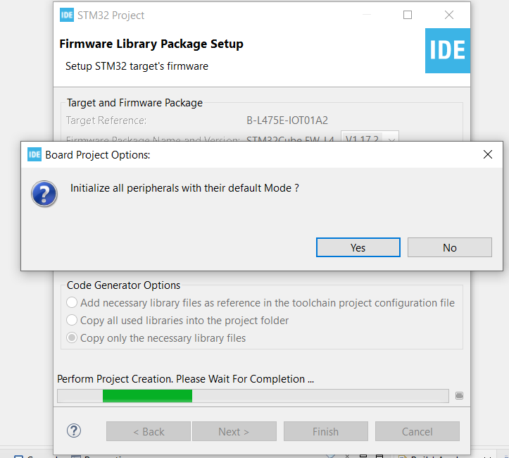
Step 5. Click yes to initialize all peripherals to default

Slide 7
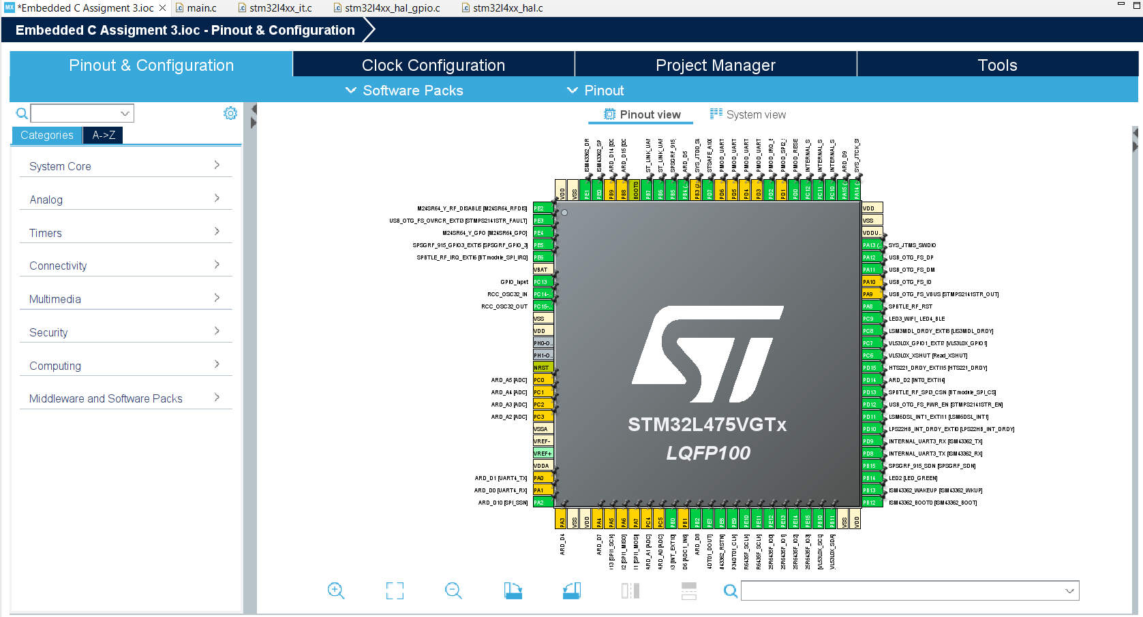
Step 6. When in .ioc file, click Pinout & Configurations. Use the default setting then generate code

Slide 8
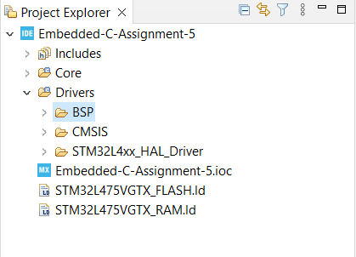
Step 7. Create BSP folder in project under drivers

Slide 9
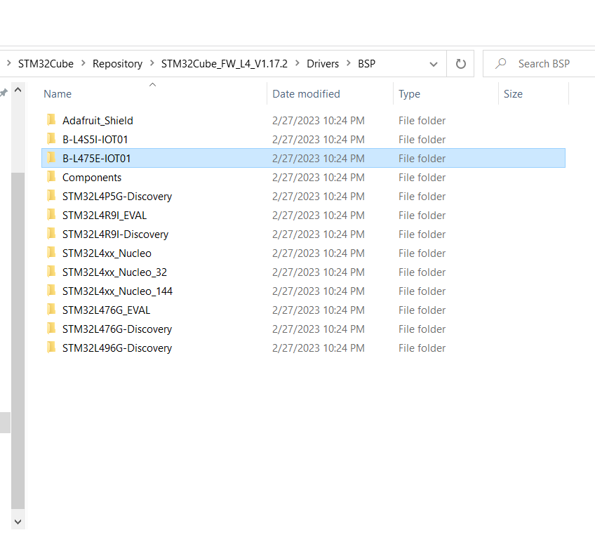
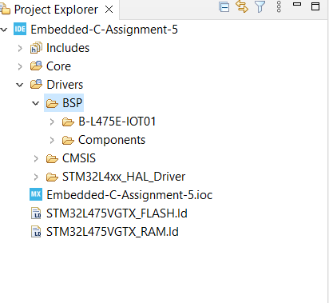
Step 8. Find the BSP location in the system, then copy B-L475E-IOT01 and Components folder into BSP folder in the project

Slide 10
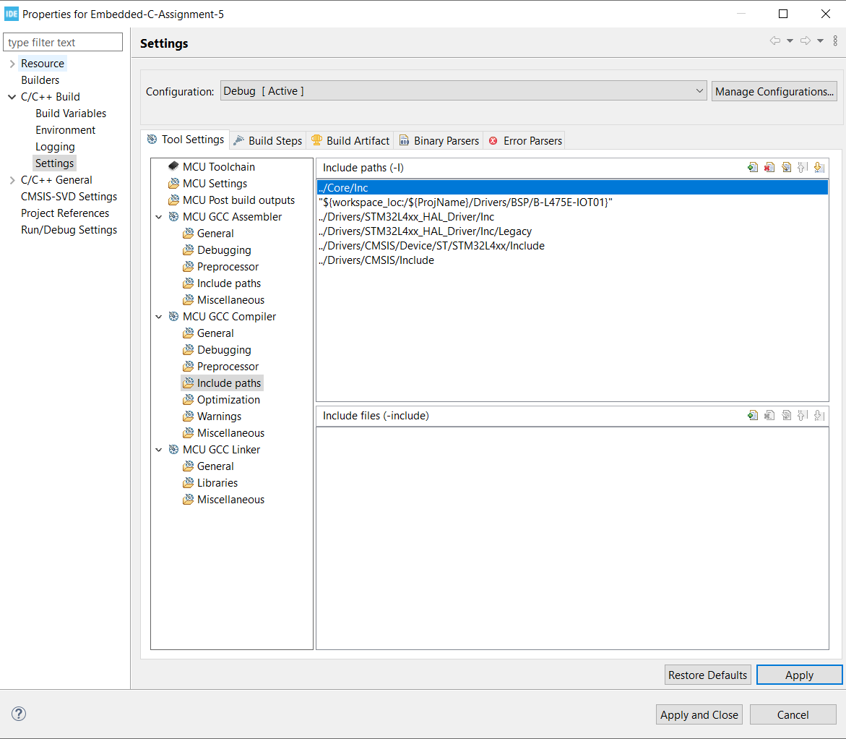
Step 9. Add the include path

Slide 11
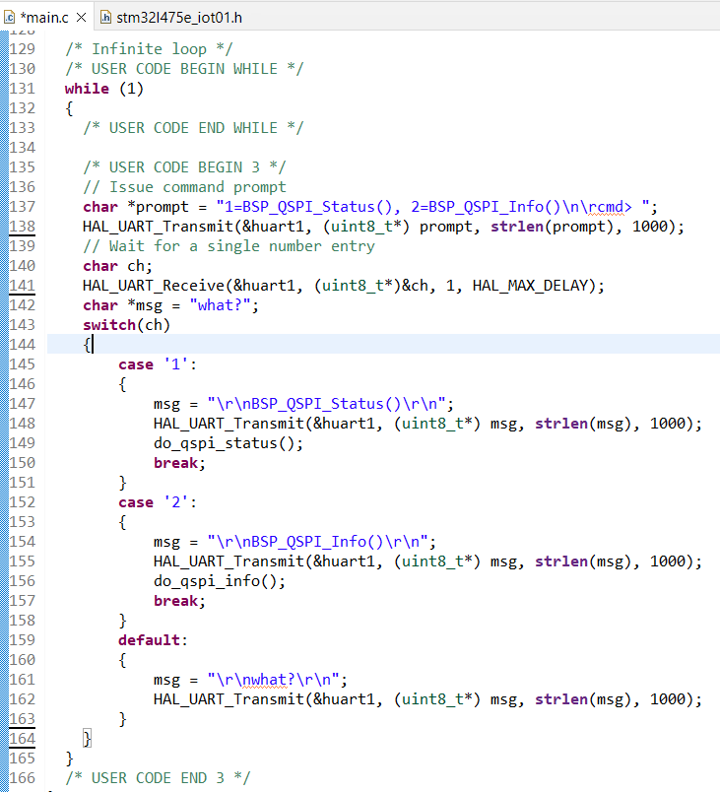
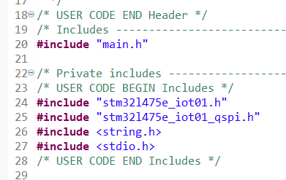
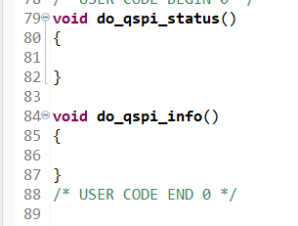
Step 10. User Story 1. CLI. Create a CLI (Command Line Interface) on UART1

Slide 12
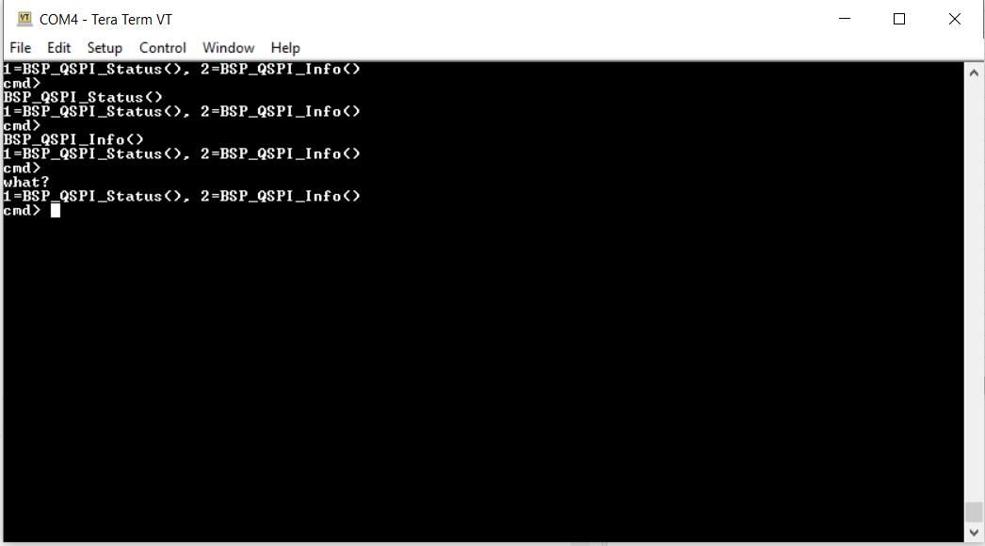
Step 11. User Story 1: Build and run the code, test is successful

Slide 13
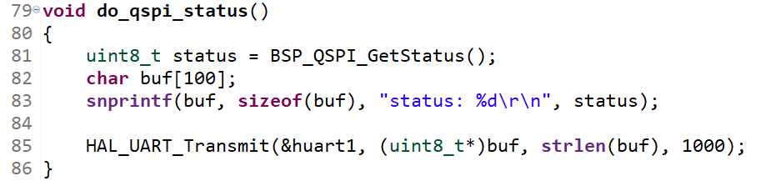
Step 12. User Story 2. BSP_QSPI_GetStatus(). When the user selects 1, display the results of calling BSP_QSPI_GetStatus() on the console.

Slide 14
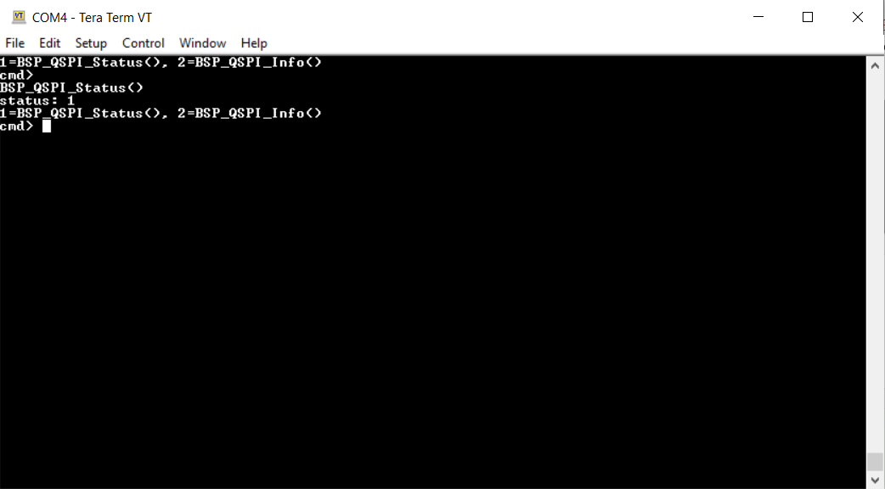
Step 13. User Story 2: Build and run the code, test is successful

Slide 15
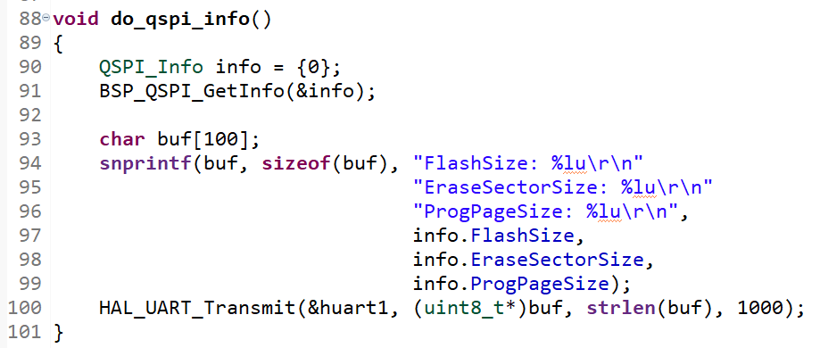
Step 14. User Story 3. BSP_QSPI_GetInfo(). When the user selects 2, display the results of calling BSP_QSPI_GetStatus() on the console.

Slide 16
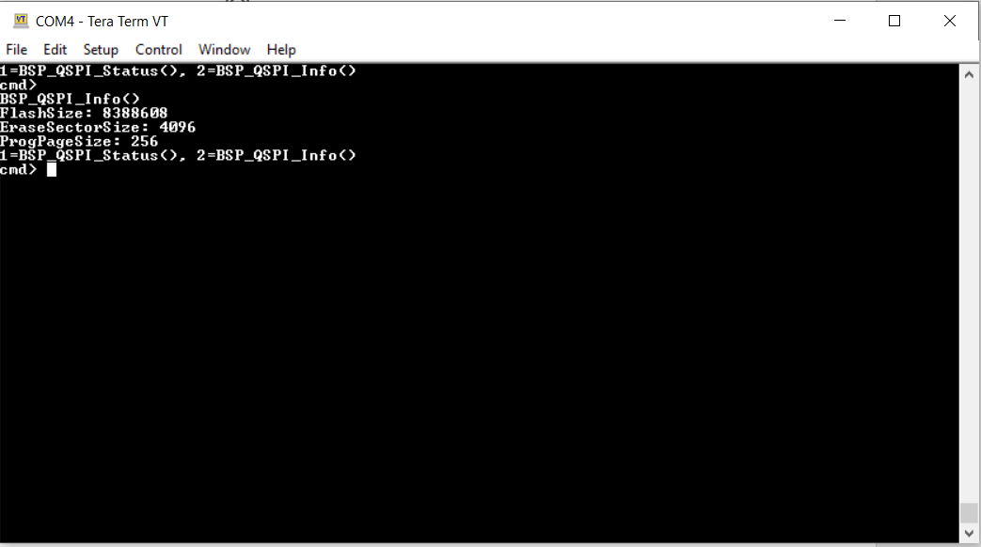
Step 15. User Story 3. Build and run the code, test is successful

Slide 17
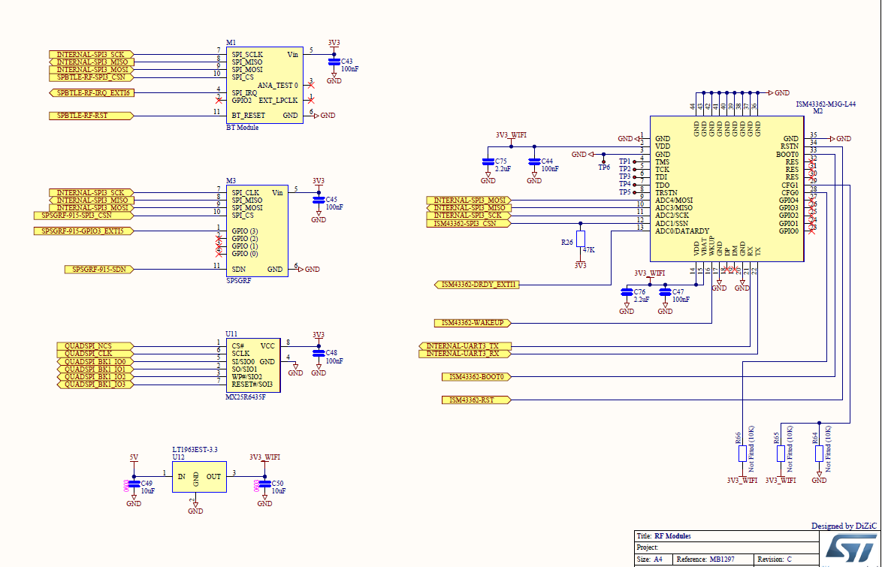
Appendix, schematic for the module on the board that use SPI as connection

Slide 18
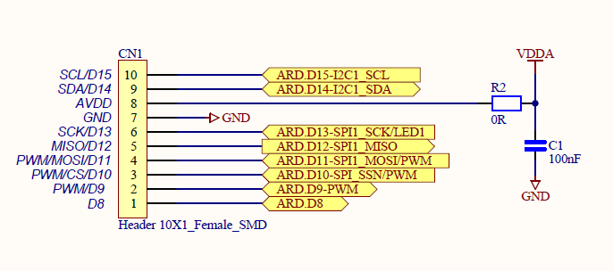
Appendix, Ardunio connector that has SPI connection

